Slide 1


Training
DB Schenker

Slide 2


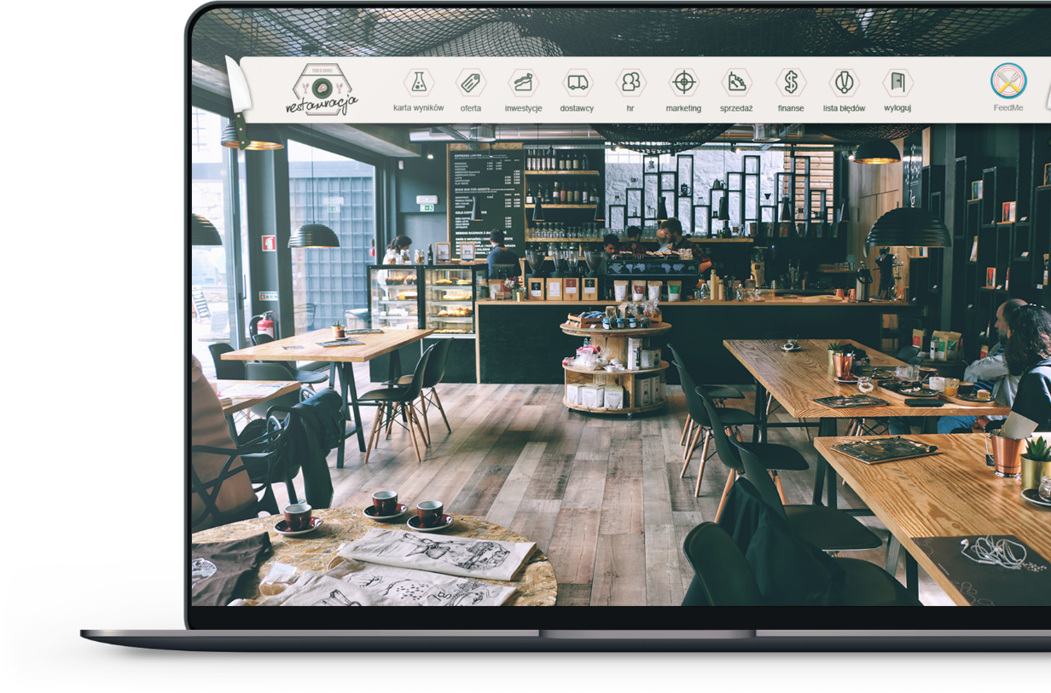
The training lasts from April 12, 2021 to May 24, 2021.
Employees will be divided into 3-4-people teams responsible for managing virtual shipping companies.
For the duration of 7 decisive rounds teams will be making realistic business decisions. There is an operational time allocated for every round - from Mondays 8:00 to Sundays until 24:00. A detailed schedule of decisive rounds is available at https://revas.online/dbschenker/. The time for making decisions is between Mondays and Sundays. Days and exact hours of the decisions do not matter. The simulation is available 24/7 through a web browser. In the simulation it is assumed that one round corresponds to one month of the virtual company’s activity.
Teams compete with each other in virtual markets. Each team has the opportunity to participate in a briefing with specialists from Revas once a week. The on-line briefings schedule is available at https://revas.online/dbschenker/.
Each of the teams operating in one of the virtual markets will have the opportunity to compare its results to the results of other teams operating in the same market. The main element that evaluates the team's performance is the scorecard (informs about the result from the previous round) and the accumulated scorecard (informs about the results from round 3 to the round in which the team is in at the moment).
Decisions made during one round may be changed any number of times. When the team advances the game to the next round, however, it will no longer be able to change previous decisions. There will be a possibility to correct the decisions as part of a current activity, though. It will be associated with incurring certain consequences, e.g. if I hire an employee in round 2, and I want to withdraw from this decision in round 3, I will have to dismiss that employee, so bear the costs of employment in round 2 and the costs of dismissal in round 3.
The last saved decision is the one being taken for calculation by the system – it means that if one of the team members makes a decision specifying the name of the company as AAA, and the other member of the same team enters the name as BBB and saves, the system will count the name BBB.
At the end of the training, the best teams will be selected.
The login page for the simulation can be found at the address www.revas.online. After entering the website, select LOG IN in the menu.

Slide 3





Ela Szczepaniak
E-mail
eszczepaniak@revas.pl
Telefon
+48 502 148 260
Want to know more about the training?
Contact me
3

